Slide 1
Security assessment of a simulated small business network
Presented by Group 13

Slide 2

Main Task Objective:
Conduct an authorized security assessment of the network and determine the most important security weaknesses.

Slide 3
Required Activities
Create a network asset inventory and annotated topology diagram.
Identify approved hosts, ports, protocols, and exposed services.
Compare expected and unexpected services and document the attack surface.
Conduct controlled asset discovery and an approved vulnerability assessment.
Manually validate selected scanner findings and identify false positives.
Assess misconfigurations, patching, permissions, insecure services, and administrative exposure.
Rank confirmed findings using likelihood, impact, exploitability, and business context.
Recommend practical remediation and retest selected issues after fixes.

Slide 4
Expected Deliverable:
Small-Business Network Security Assessment Report with at least five well-supported findings.

Slide 5
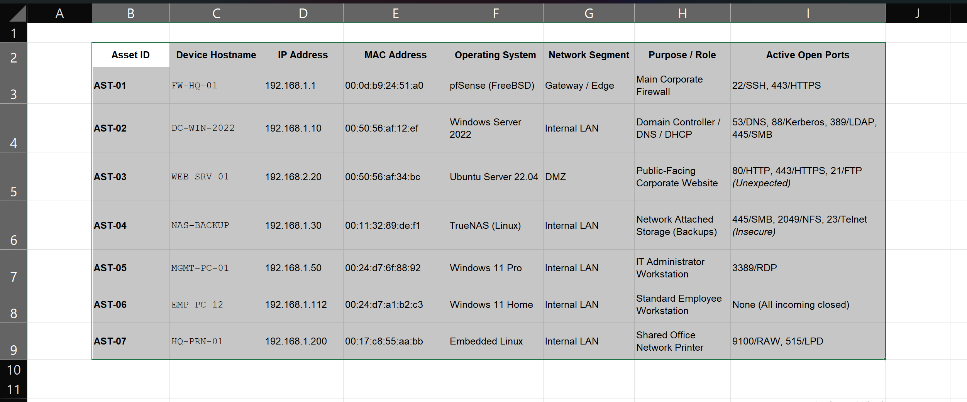
Network Asset Inventory

Slide 6
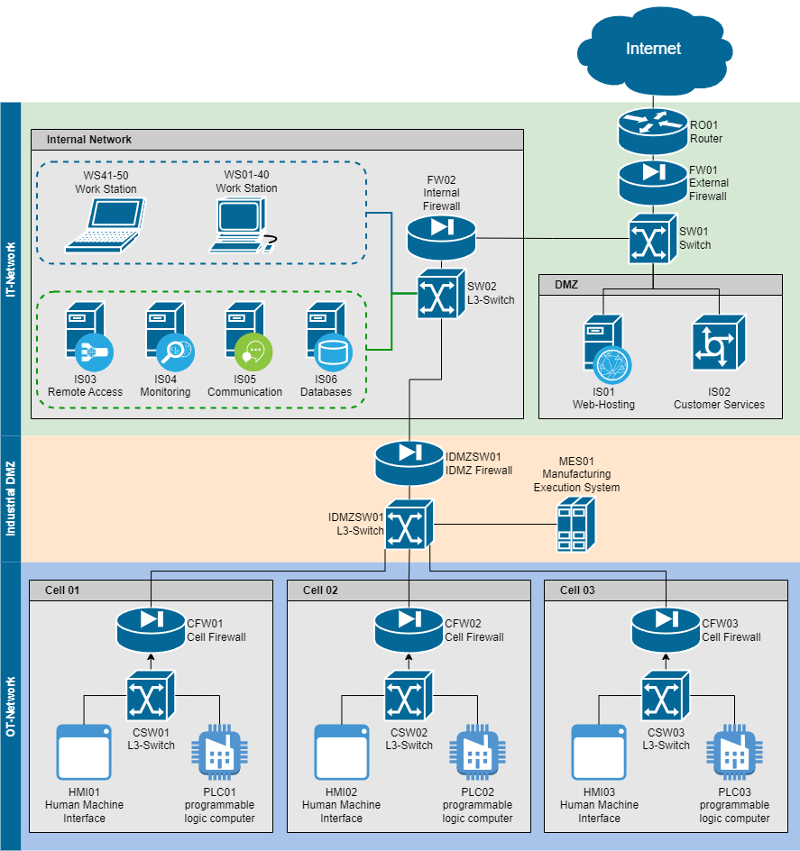
Annotated Topology Diagram

Slide 7
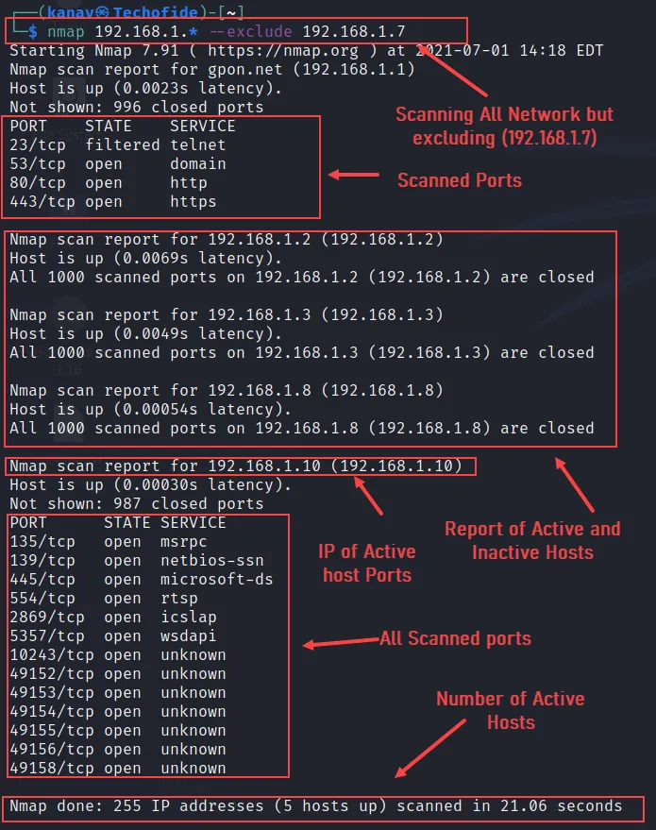
Host Discovery& Port Scanning

Slide 8
Attack Surface & Service Discrepancy Analysis

Slide 9
A comparative analysis was conducted between the organization’s expected business services and the actual active services discovered during the network scanning phase. Unnecessary or unauthorized services directly expand the network's attack surface and introduce avoidable security risks.

Slide 10
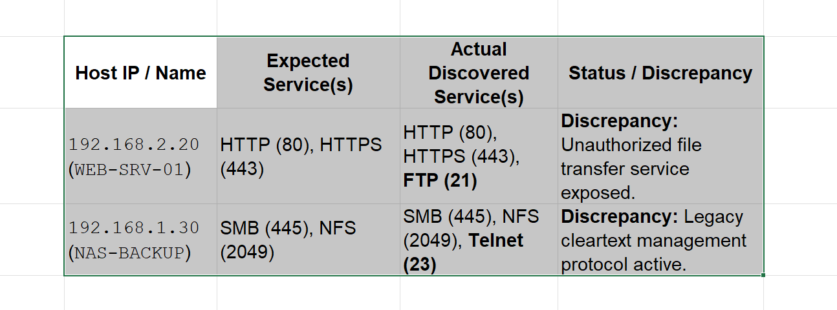
Service Comparison Summary

Slide 11
Analysis of Expanded Attack Surface
Host 192.168.2.20 (Public Web Server): This asset is strictly designated to host the public corporate website. However, active port scanning revealed an open FTP (Port 21) service. Because this server sits in the public DMZ, exposing an unmonitored file transfer port significantly broadens the attack surface, inviting brute-force access attempts and potential web directory traversal attacks.
Host 192.168.1.30 (Internal NAS Backup): This device functions as the internal storage repository for corporate backups. In addition to expected file-sharing protocols, the system was found to be exposing Telnet (Port 23). Telnet transmits administrative credentials in cleartext, meaning any internal adversary or malware performing packet sniffing could easily capture the network storage root password.

Slide 12
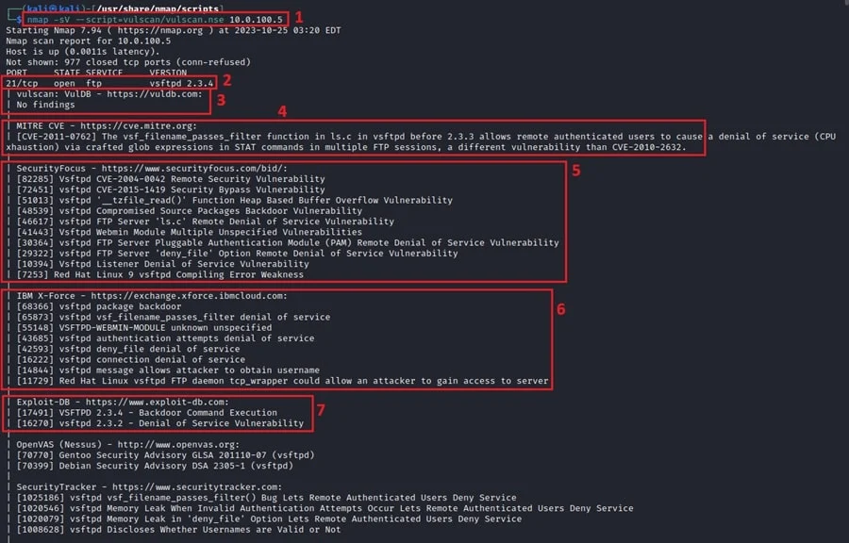
Vulnerability Assessment

Slide 13
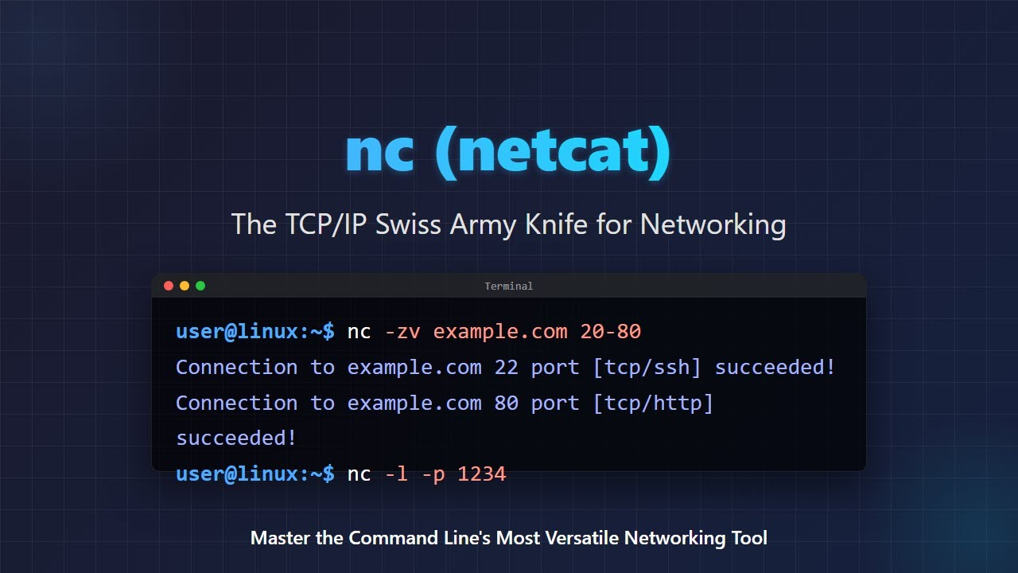
Manual
Verification

Slide 14

Deep Dive Assessment Areas
Misconfigurations:
Default passwords left unchanged
Anonymous login allowed on FTP

Slide 15
Risk Ranking Matrix
Risk Score = Likelihood X Impact
Scoring Criteria (1 to 5 Scale)
Likelihood:
1 = Rare/Near Impossible,
3=Moderate(Requires effort)
5 = High(Public exploit available)
Impact:
1 = Insignificant,
3 = Moderarte (Local disruption)
5 = Catastrophic (Full domain takeover / Data Leak)

Slide 16
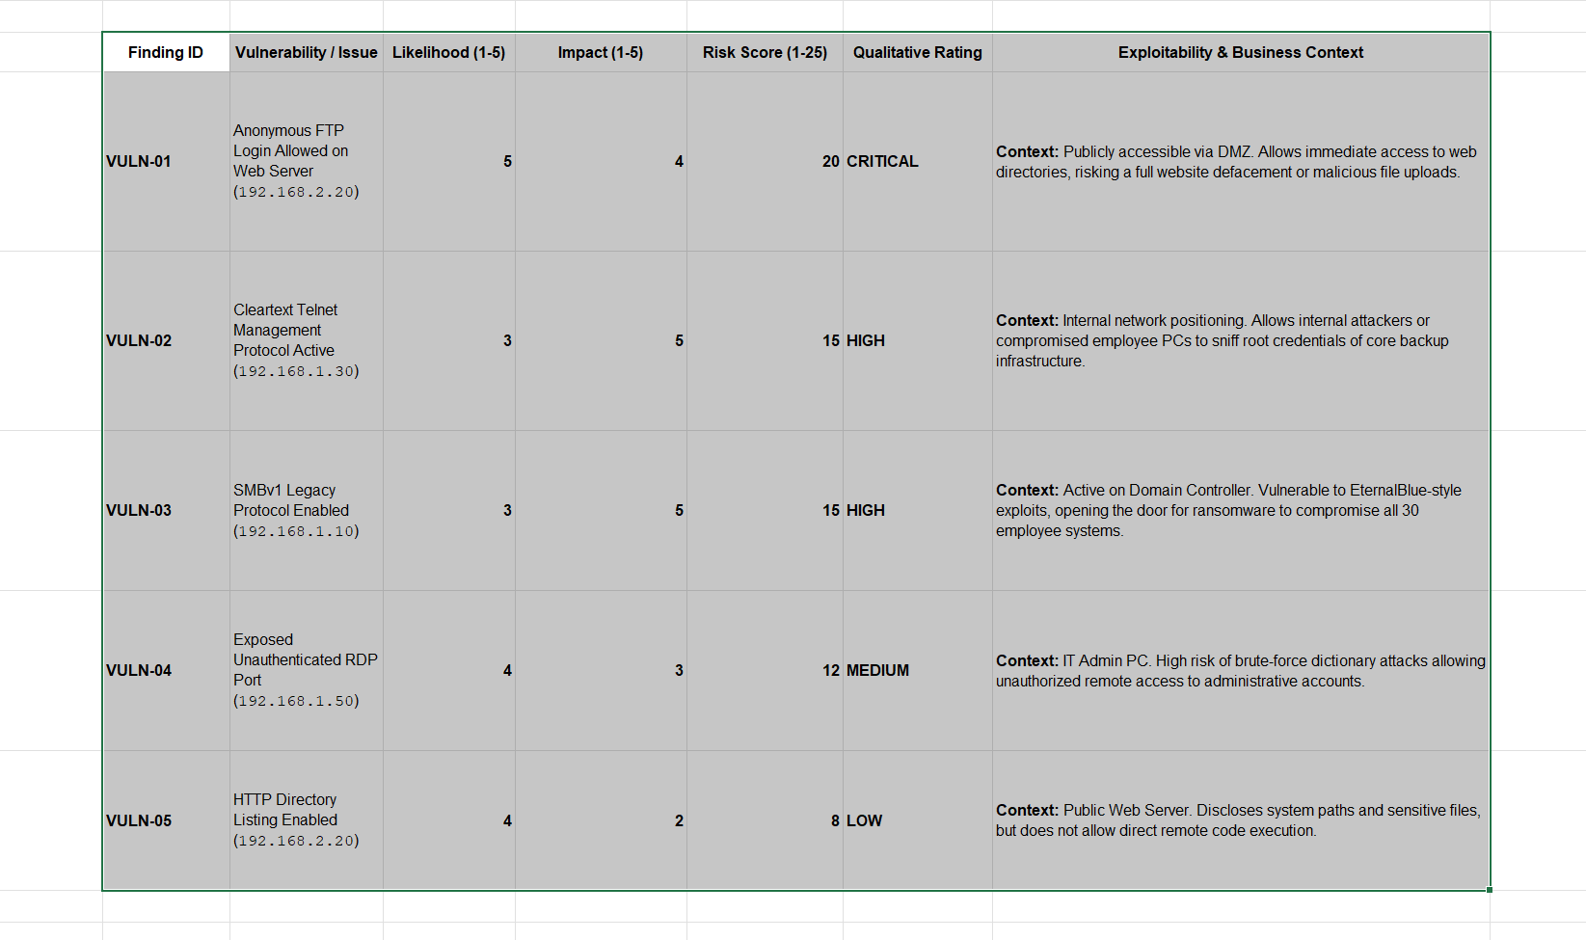
Consolidated Finding Matrix

Slide 17
Remediation & Retesting
This is the prescriptive section of our security assessment report, detailing exactly how the client resolves the top security issues and how we verified the fixes.

Slide 18
Remediation & Retesting Logs
Finding VULN-01: Anonymous FTP Enabled
Remediation Instructions:
  Open the FTP server configuration file: sudo nano /etc/vsftpd.conf
  Locate the line anonymous_enable=YES and change it to anonymous_enable=NO.
  Save the file and restart the service: sudo systemctl restart vsftpd.
Retesting Procedure & Evidence:
  Action: Run an Nmap NSE script against port 21: nmap --script ftp-anon -p 21 192.168.2.20
  Expected Result: The output must confirm that anonymous login is explicitly rejected or that the port is closed.
Finding VULN-02: Cleartext Telnet Active
Remediation Instructions:
  Permanently stop and disable the Telnet service daemon: sudo systemctl stop inetd and sudo systemctl disable inetd.
  Deploy SSH (Port 22) as the mandatory encrypted replacement protocol for secure management.
Retesting Procedure & Evidence:
  Action: Run a targeted network socket probe: nc -vn 192.168.1.30 23
  Expected Result: Connection timeout or "Connection Refused" confirmation string.
Finding VULN-03: SMBv1 Enabled on Domain Controller
Remediation Instructions:
  Open PowerShell on the Domain Controller as Administrator.
  Disable the protocol natively using the command: Disable-WindowsOptionalFeature -Online -FeatureName SMB1Protocol.
  Reboot the Domain Controller.
Retesting Procedure & Evidence:Action: Scan using Nmap's targeted SMB dialect checker script: nmap -p 445 --script smb-protocols 192.168.1.10
Expected Result: Output demonstrates support strictly for modern cryptographic dialects (SMBv2 and SMBv3) while excluding SMBv1 entirely.

Slide 19

Thank you

